Slide 1

Kewa Prevention Program
Prevention Specialists: Jay Quintana and Sharon Aguilar
Evaluator: Sindy Sacoman, MPH

Slide 2
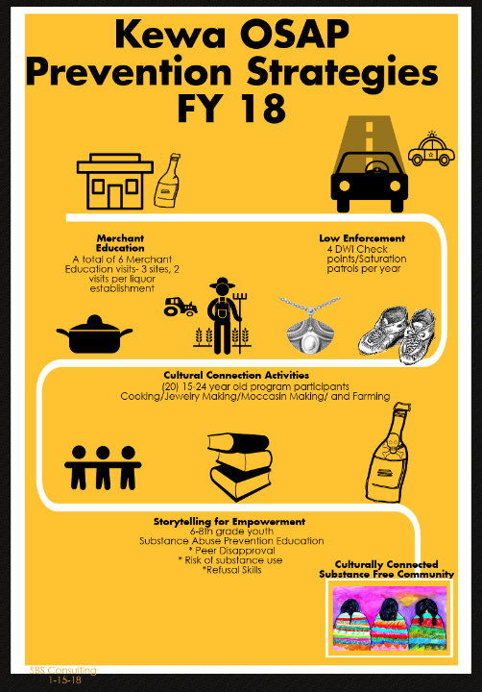
Notes:
Our entire strategic plan in one pg summary used with Tribal Council
Mention SPF Process and Direct Services

Slide 3
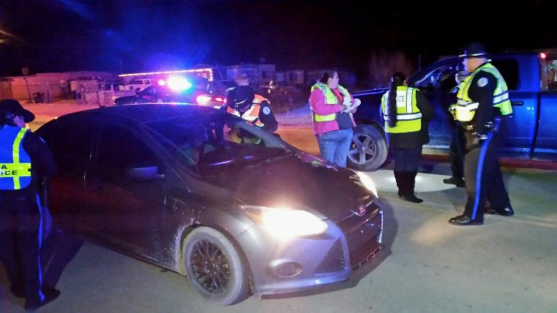
Law Enforcement

Slide 4
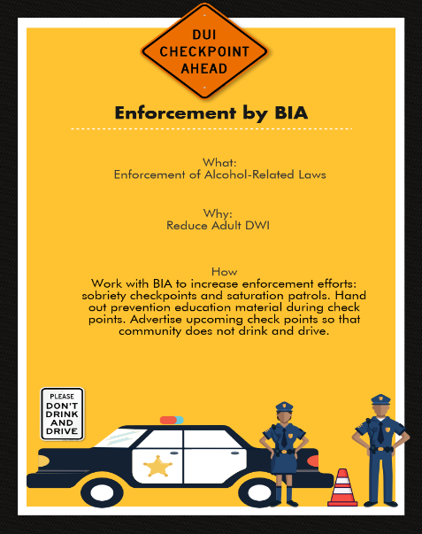
Notes:
Building relationship with BIA- our prevention program was the first to develop the relationship, capacity building- training of To’s. Letter from Chief to Gov.
Chief called preventionist to assist with resources for mental health crisis bc prevention was his only point of contact.
Building of relationship
Meeting with BIA to request data- first time BIA shares data with Pueblo.
BIA contacting Jay- point of contact and resource for prevention (conducted a meth presentation for youth conference)-
Letter from BIA to Gov.

Slide 5
Letter from BIA to Governor
Governor Coriz,
I’d like to express my gratitude in working with the Kewa Family Wellness Center-Prevention Program. Prevention Specialist Jay Quintana and Prevention Program Coordinator Paula Garcia have been meeting with our department over the past several months addressing current Mental Health issues within the community. The wellness program has also taken the lead in creating a Mental Health Crisis Protocol. They asked for our assistance and we meet monthly.
This morning Officer Chama and I responded to a call where a tribal member needed the kind of assistance that the Kewa Family Wellness Center-Prevention Program provides. I was able to reach Kewa Family Wellness Center-Prevention Program and work with them to get the immediate assistance the tribal member needed
I believe this was accomplished through the relationship and commitment between the Kewa Family Wellness Center-Prevention Program and our department
Thank you for your time and stay safe.
Travis LeBeaux
Chief of Police Bureau of Indian Affairs Office of Justice Services Southern Pueblo Agency

Slide 6
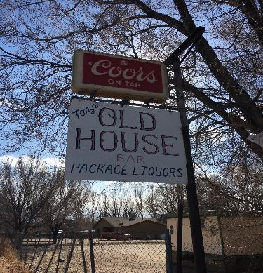
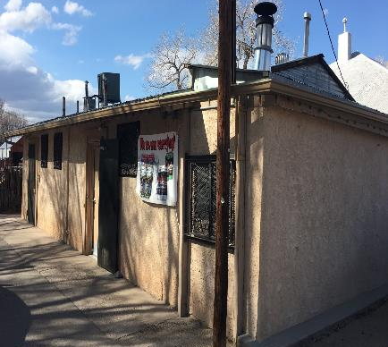
Merchant Education

Slide 7
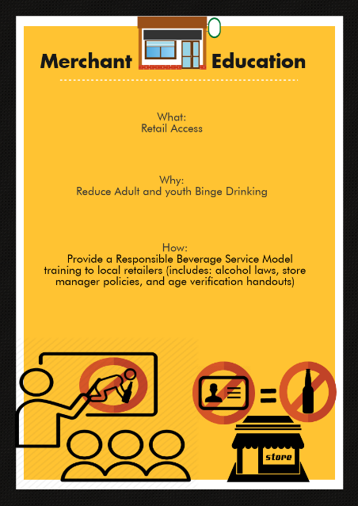
Notes:
Mention that for the summary pages provided to Tribal Council that we include the desired outcomes

Slide 8
RBSM Training
Tactics and Tips to prevent underage alcohol sales
Checking Identification the right way
Employment Agreement
Tips for Merchants
Notes:
Pena Blanca retailer –went over and gave her a copy of our RBSM Training packet and went over packet with her, focusing on checking ID’s, resources and recommendations on how to protect herself and her business also Mentioned 4th degree felony for purchasing alcohol for a minor
No Citations
Certificate
Feedback from local retailer- Pena Blanca- issue with alcohol sales to community members. Met with hostility at first- repaired relationship and Manager shared difficulties she has with community members- she is doing her part to be a responsible service manager.
Requested resources to report problem customers- Example of intoxicated clients that she turns away- they use uber and runners, stealing
Gave her TO’s number the TO’s can be aware of who is intoxicated in the pueblo also advised to call Sheriffs office in Sandoval county and if she felt in danger call 911

Slide 9
Resources and Recommendations for store Policies and Procedures
Implementing a Responsible Beverage Service Improvement Process
Best Practices and Recommended Policies
  -Hiring and Training Staff
  -Things to Do During the Hiring Process
  -Tips for Training Employees
  -Establish a Responsible Beverage Service System
Sample Alcohol Sales Policy
Preventing Underage Alcohol Service
  -Tips for Identifying Minors
  -`No Proof – No Service’ Policy
Notes:
Let employees know that as an employee you will be held liable as an individual as a business they can be cited by SIU
Sheriffs office only cite criminal citations. SIU sites them as an establishment which is an administrative citation and goes against their liquor license if they get three citations they will lose their Liquor license only SIU can cite this.
2nd bullet –Training for Pena Blanca where we will be giving additional training on alcohol sales and correct ways to check ID’s
3rd and 4th bullet – presented signs 1996 to make sure over 21
Also horoscope sign to ask sign if still not sure over 21
Refuse service sign – still not sure if over 21 are able to refuse service

Slide 10
Notes:
We are representative of Tribe and letter represents our efforts to work with the retailers as a collaborative team.

Slide 11
Notes:
These are other example of signage that they can use for customers and employees to reference.
Go more in depth if unsure if it’s there personal ID or if they have doubts can refer to refusal sign

Slide 12
Notes:
This can be used for intoxicated patrons and underage as a policy to refuse service.

Slide 13
Notes:
Once we get report from Sandoval office FY17 stating they did not have any violations and Merchants completed the training they will receive a Certificate of Achievement.
Made Certificate for Retailers to recognize them as a responsible retailer with no violations

Slide 14
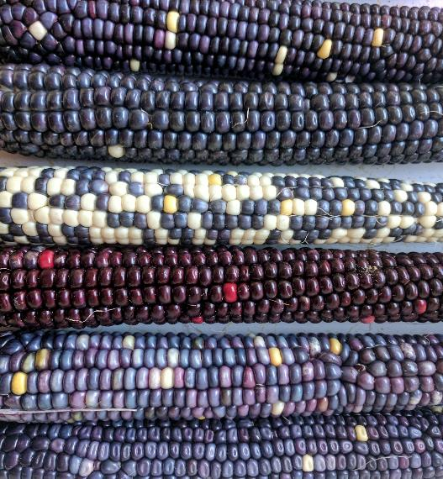
Cultural Program

Slide 15
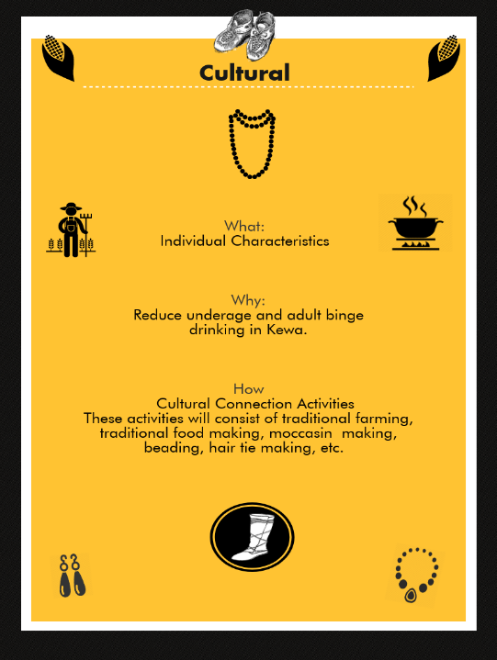
Notes:
Community requested traditional skills, traditional skills are known as protective factors. These protective factors would increase self-esteem and self-identity and connection to culture.
Youth have been loosing traditional skills- loss of language and loss of culture has led to increased alcohol use.

Slide 16
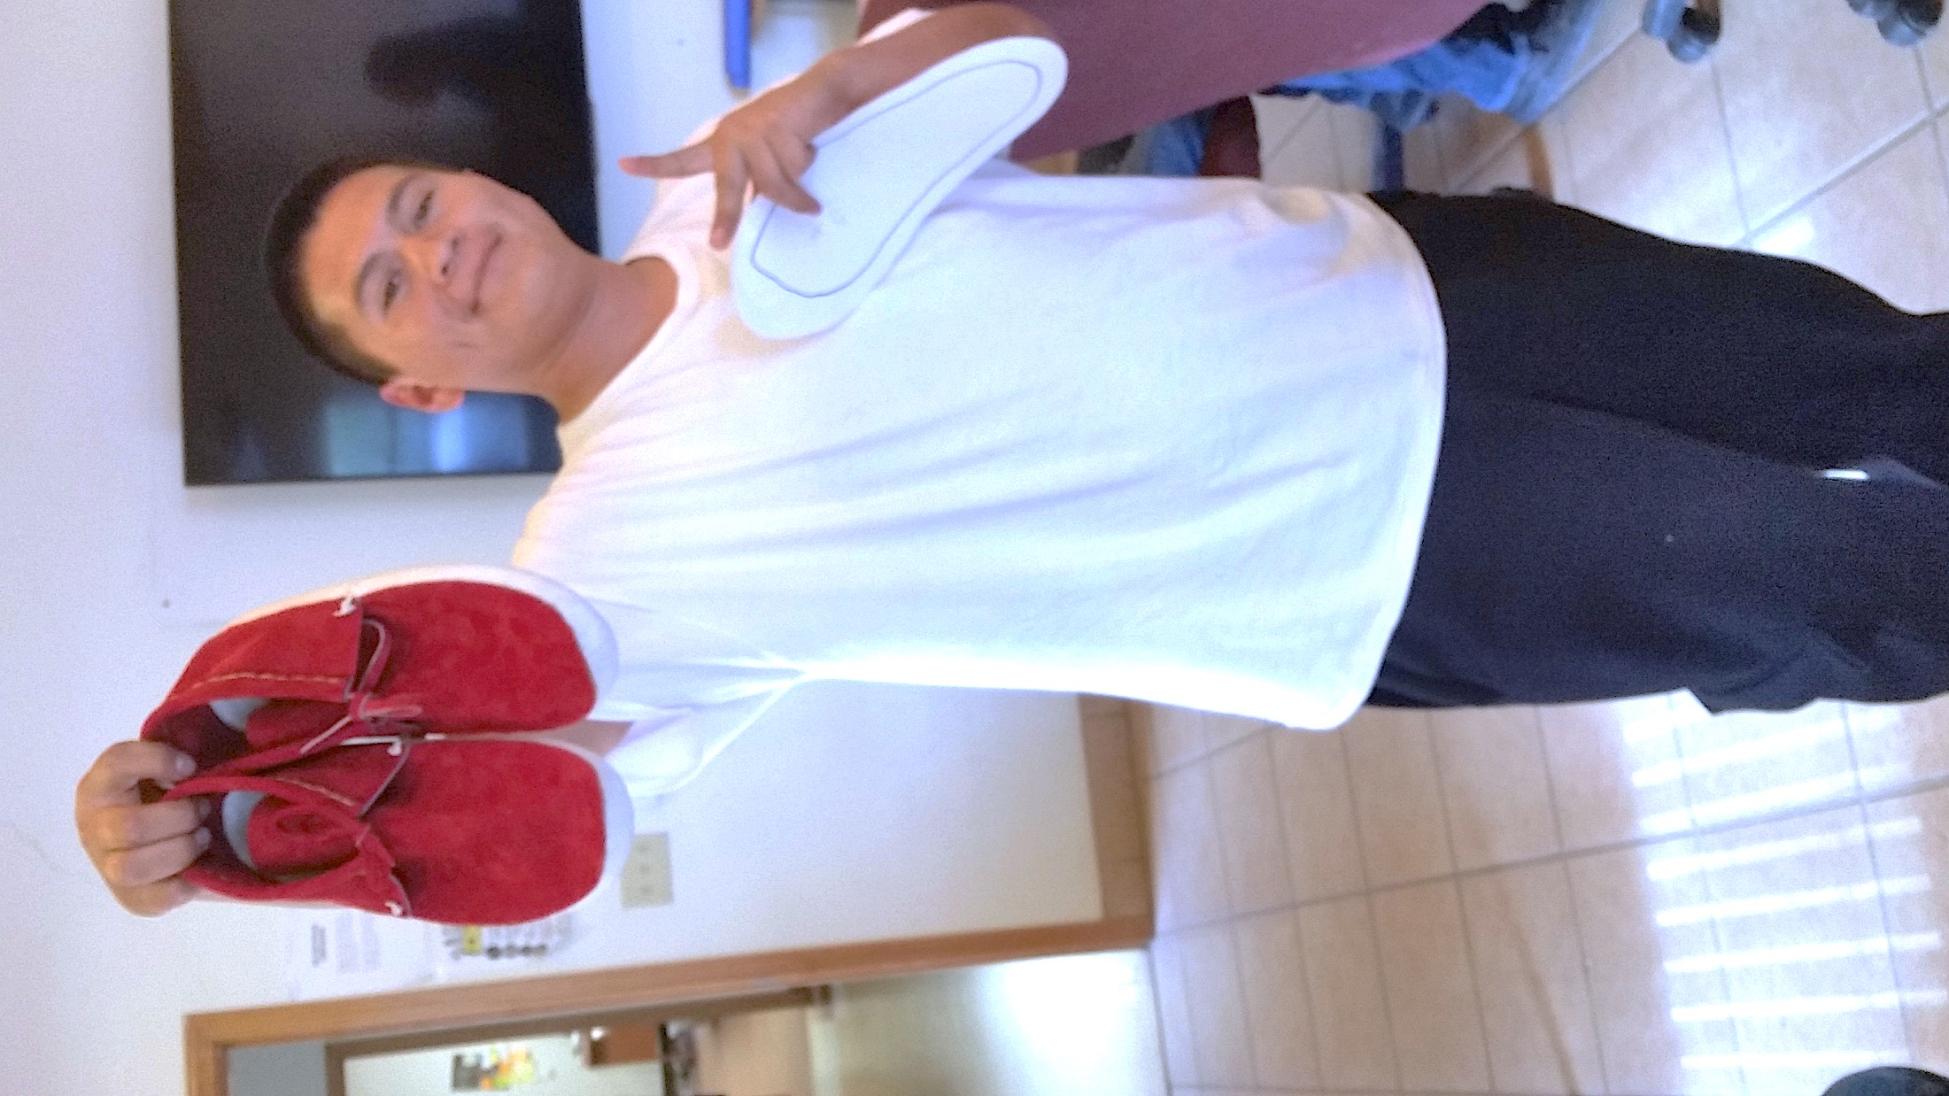
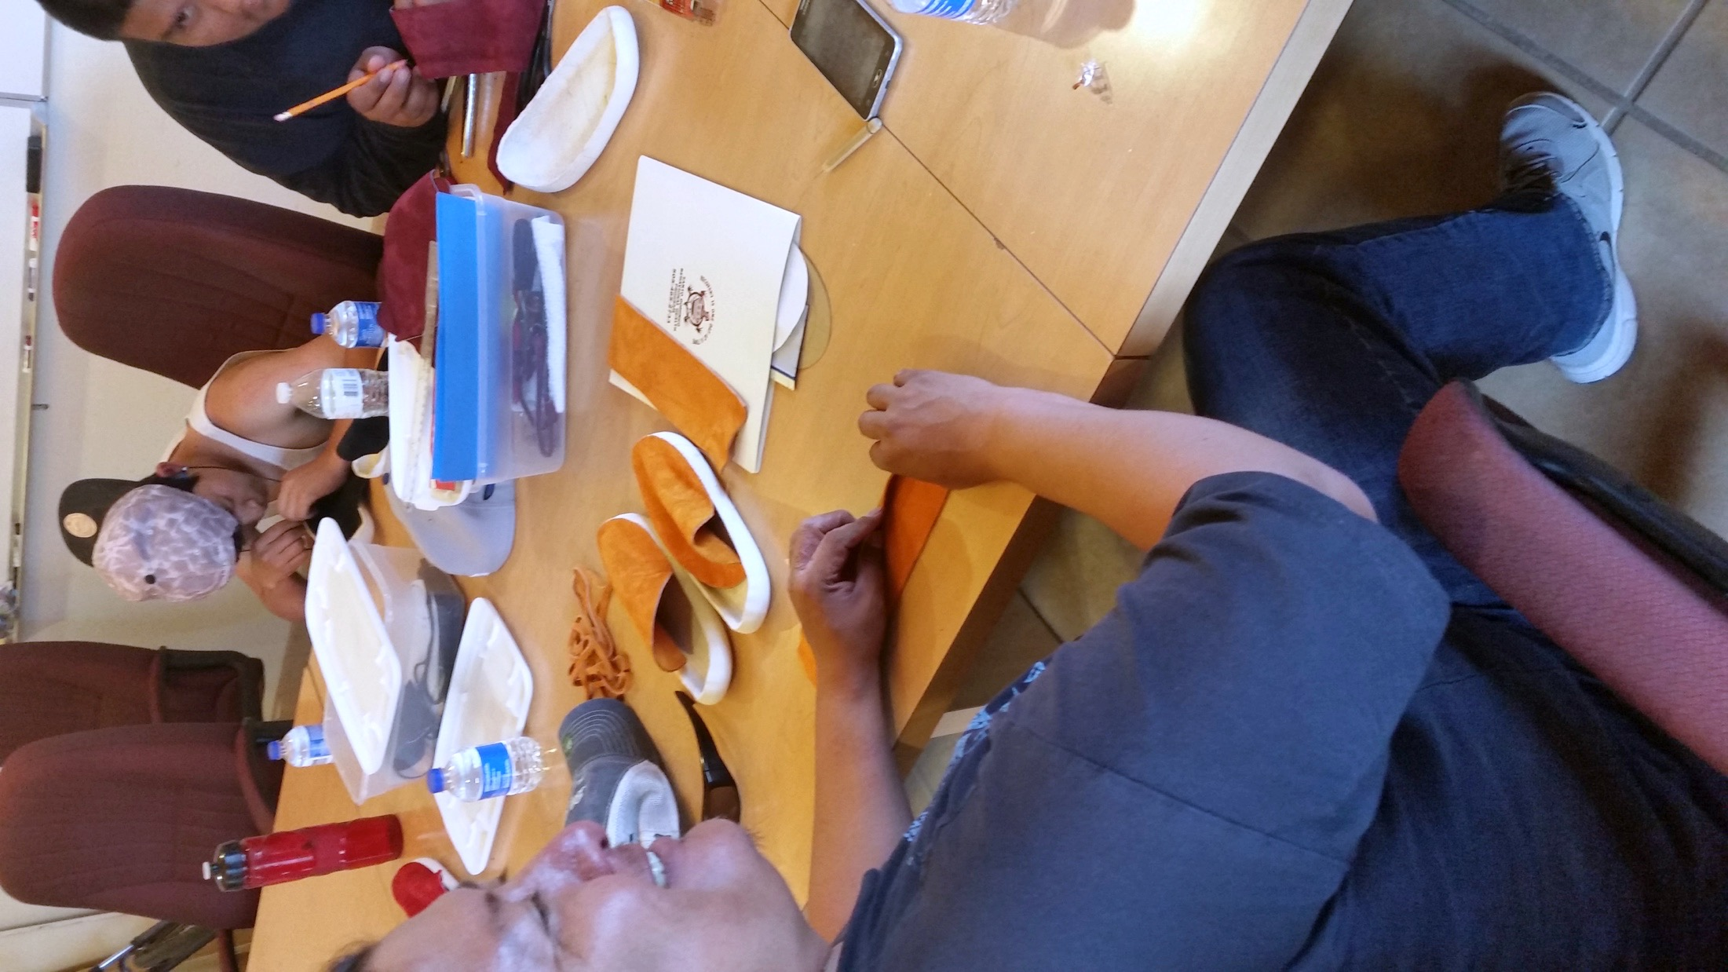
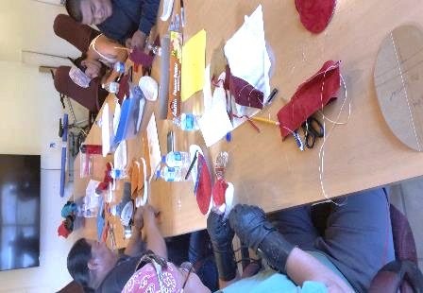
Moccasin Making
Notes:
Here is an example of …

Slide 17
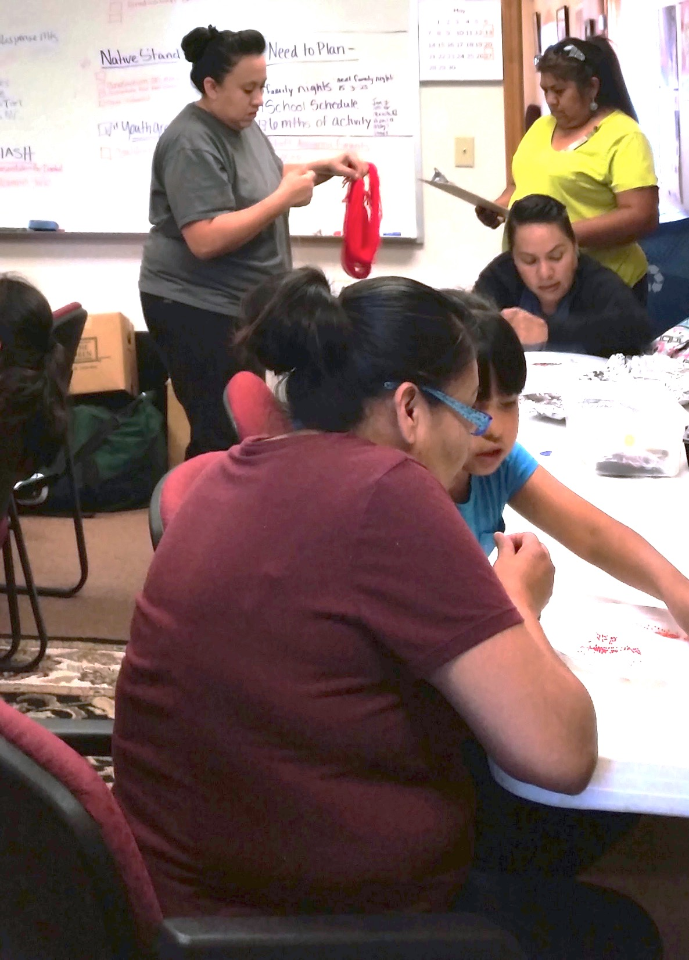
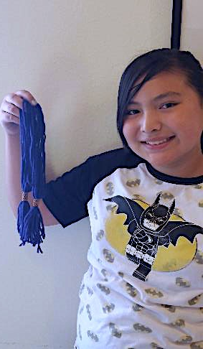
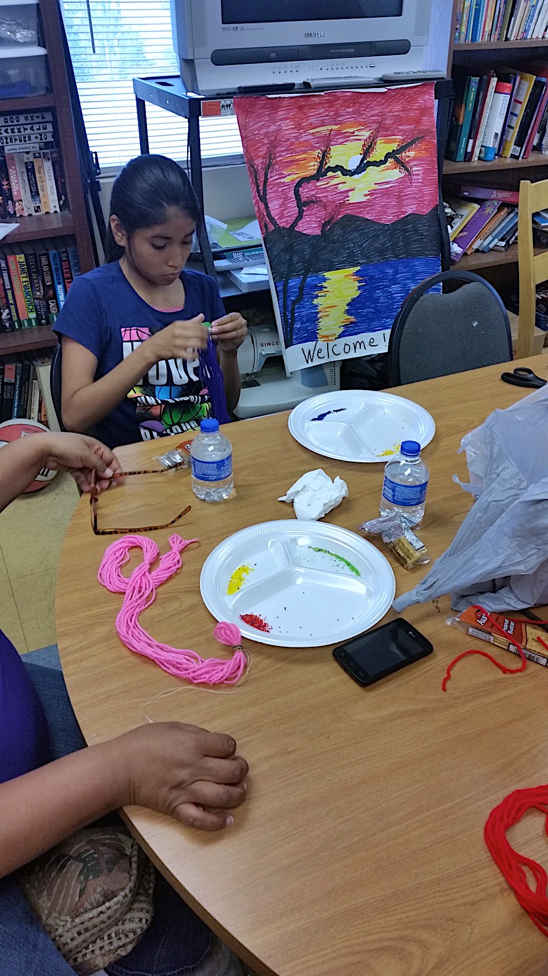
Bead Work

Slide 18
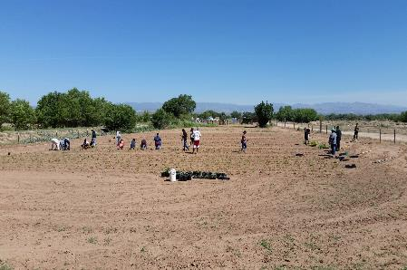
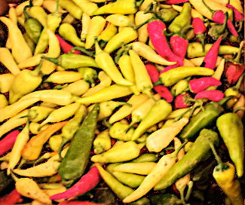
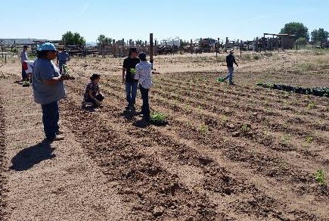
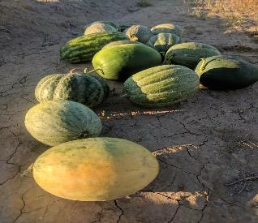
Farming
Notes:
Farming watermelon, chili, corn etc.

Slide 19
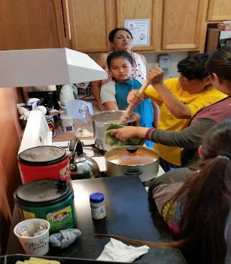
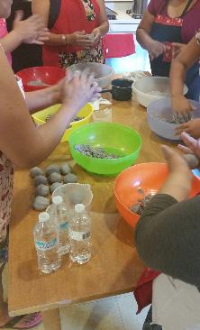
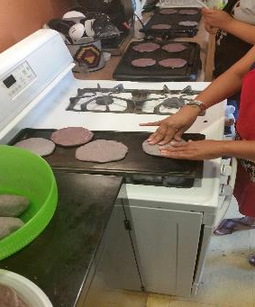
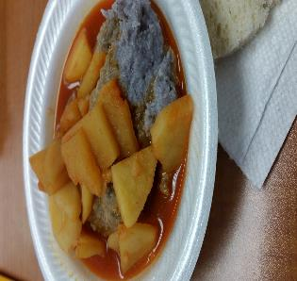
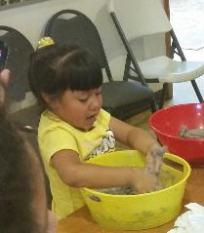
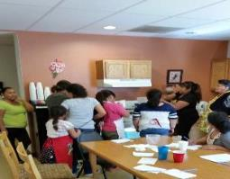
Women’s Traditional Cooking
Notes:
Blue corn tortillas
Blue corn mush w/ potatoes and red chili

Slide 20
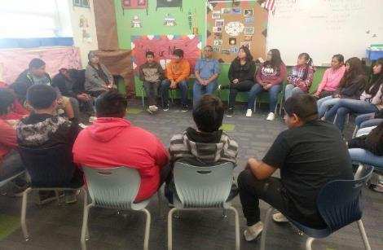
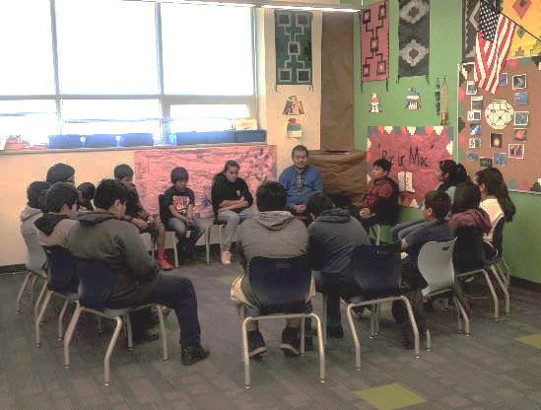
Storytelling
Notes:
Storytelling with Elders (male/female- shared cultural and gender specific roles)

Slide 21
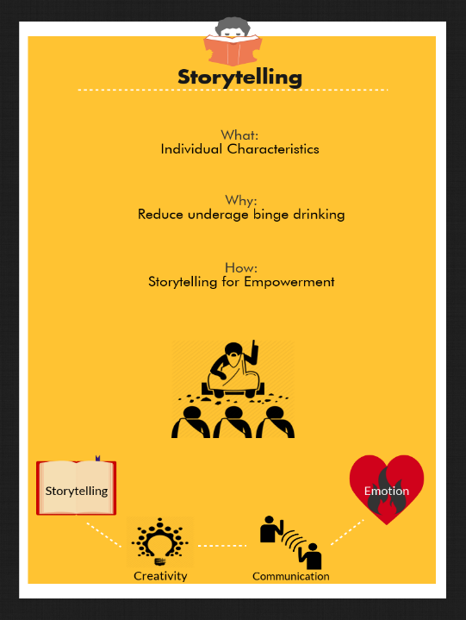
Notes:
Direct service targeted 6th 7th and 8th graders
Year before- only had 12 kids that finished bc late approval from state the way we ran we could only contact 12 kids
2nd time around contacted a school which had a Keres language program and collaborated with the language classes and because of this we were able to target students and get a group of 79 kids for the Storytelling program
- The storytelling curriculum let us adapt our traditional stories to the curriculum.
- Reached out to elders as our resource to traditional stories (Volunteers)
Over the amount of time 12-14 weeks we seen big changes with the kids especially with kids that were not responsive in the beginning. We notice they were more engaged and responsive to curriculum.
-Requesting more stories-more engaged in their culture and traditional teachings strengthened their cultural identity.
-Not only taught them about substance abuse but it also taught them about their body and brain and how the body and brain are affected by substances.
- story tellers used traditional stories to teach them lessons about life and how to be clean and sober and to respect their body
-The students learned self confidence ,refusal skills and how to be strong against peer pressure.

Slide 22
Storytelling Results
5% increase in knowledge (alcohol)
9% increase in knowledge (marijuana)
28% increase in knowledge (opioid)
16% increase perceived risk of harm (alcohol)
22% increase perceived risk of harm (marijuana)
12% perceived peer disapproval (alcohol)
12% perceived peer disapproval (marijuana)
14% refusal skills (alcohol)
11% refusal skills (marijuana)

Slide 23
Notes:
Assignment circle name in the middle and then add character traits and what they see themselves doing in the future their dreams and goals

Slide 24
Notes:
Go over some traits and jobs that are normally not seen in the pueblo like NFL player, Prof Volleyball player, Air force pilot, S.W.A.T, Doctor etc.

Slide 25
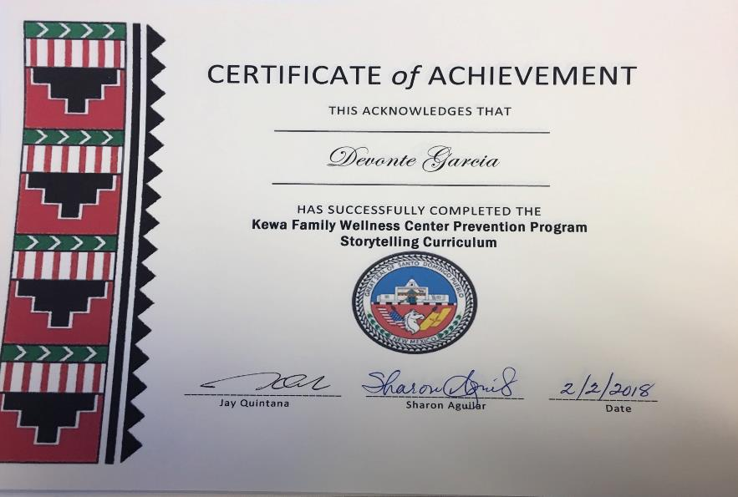

Slide 26
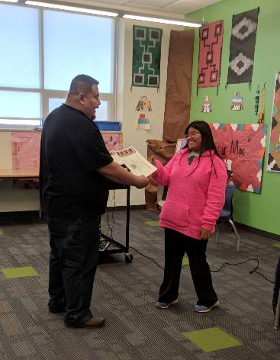
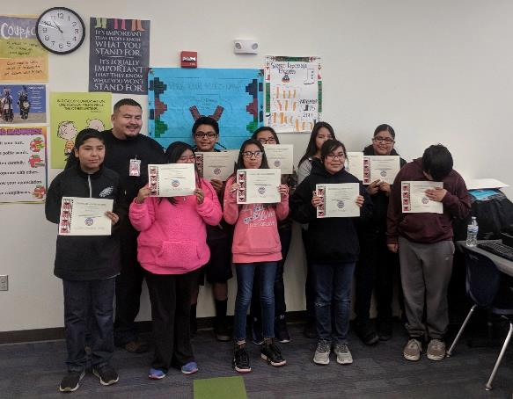
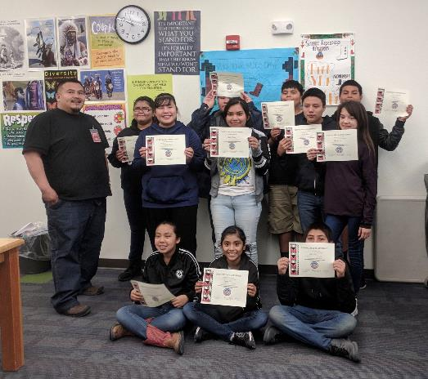
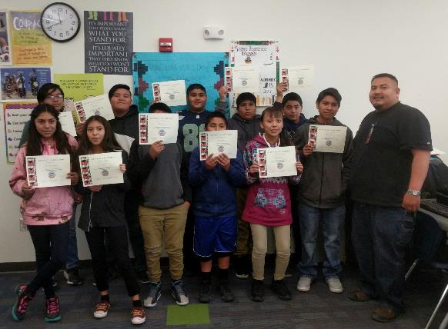
Notes:
All graduation class Feb 2, 2018 total of 79 kids these are some of our graduating classes

